Slide 1
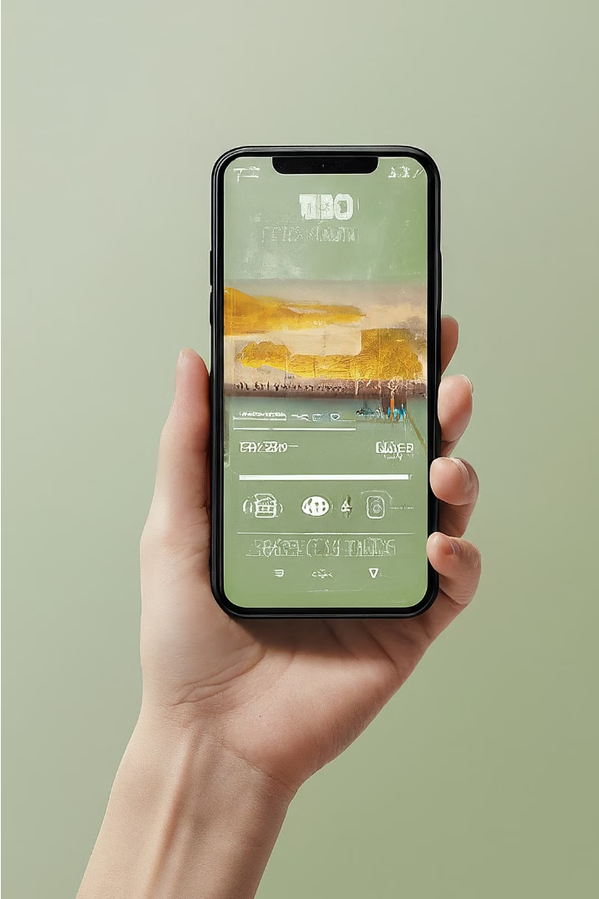
Introduction to the Music App
The Music App is a powerful and intuitive platform that allows users to seamlessly discover, stream, and manage their favorite music. With a clean interface and advanced features, the app enhances the listening experience and puts the joy of music at your fingertips.

Slide 2
Key Features of the Music App
Personalized Recommendations
Offline Playback
High-Quality Streaming
Download your favorite tracks and albums to listen to offline, ensuring uninterrupted enjoyment on the go.
Enjoy crystal-clear audio with the app's seamless high-definition streaming capabilities, ensuring an immersive listening experience.
The app's intelligent algorithm analyzes your listening habits to suggest new artists, albums, and playlists tailored to your musical preferences.

Slide 3

How to run Music App
1
Download
2
Setup
3
Enjoy
Download the vs code, JDK, and Three jar files as well as the SQL connector. Three jar files are: 1. mp3agic JAR 0.9.0 .
2. jlayer JAR 1.0.1.
3. jaudiotagger
Download the zip file. Open the file in vs code. Select the folder for the music app. Run the program from app.java file. Then select the music from all songs.
Now you can listen and enjoy the music. You can customize your own music background color and as well as create your own playlist.

Slide 4



Data Management using Database and File
Database
File Management
User Playlists
The app utilizes a robust database to store user information, music metadata, and listening history securely.
Offline music files are efficiently managed and cached to ensure seamless playback and easy access.
User-created playlists, along with their customizations and preferences, are securely stored using a combination of database and file-based storage solutions.

Slide 5

Conclusion
The music player is a very friendly and easy-to-use application developed using Java. Where the user can customize their own playlist as well as the application background color.

